Slide 1
How to use arrays and collections
Chapter 4

Slide 2
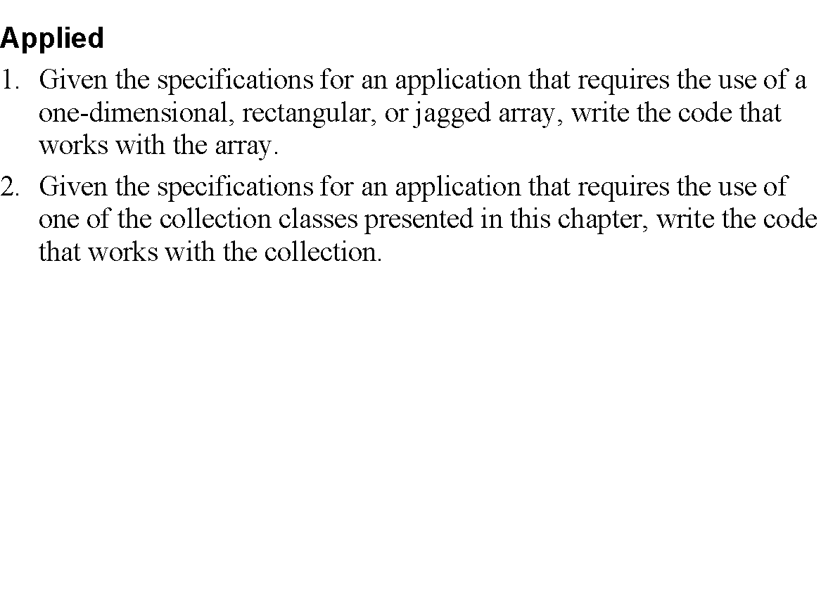
Objectives

Slide 3
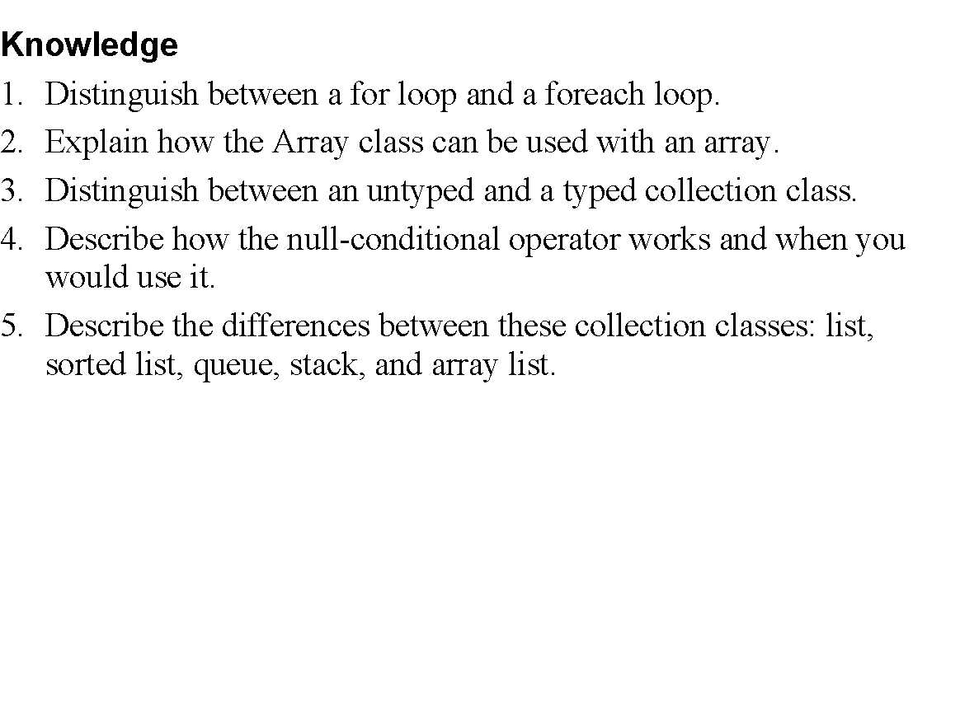
Objectives (cont.)

Slide 4
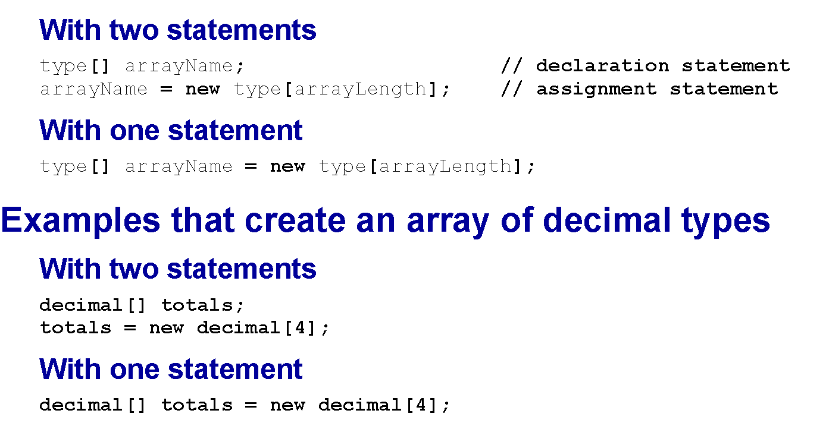
The syntax for creating a one-dimensional array

Slide 5
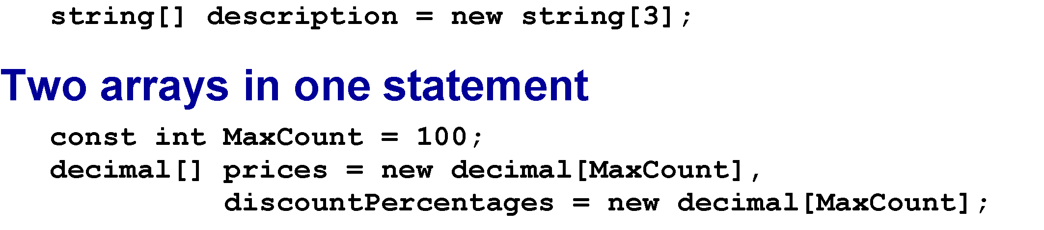
An array of strings

Slide 6
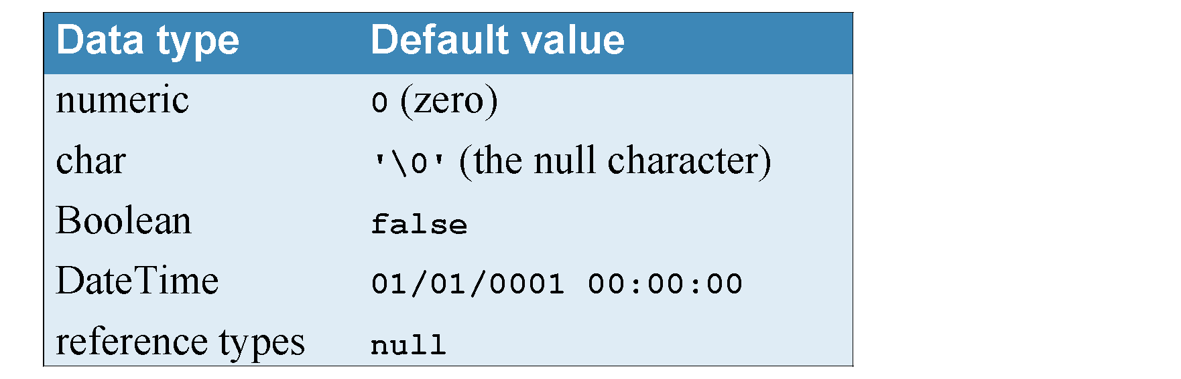
Default values for array elements

Slide 7
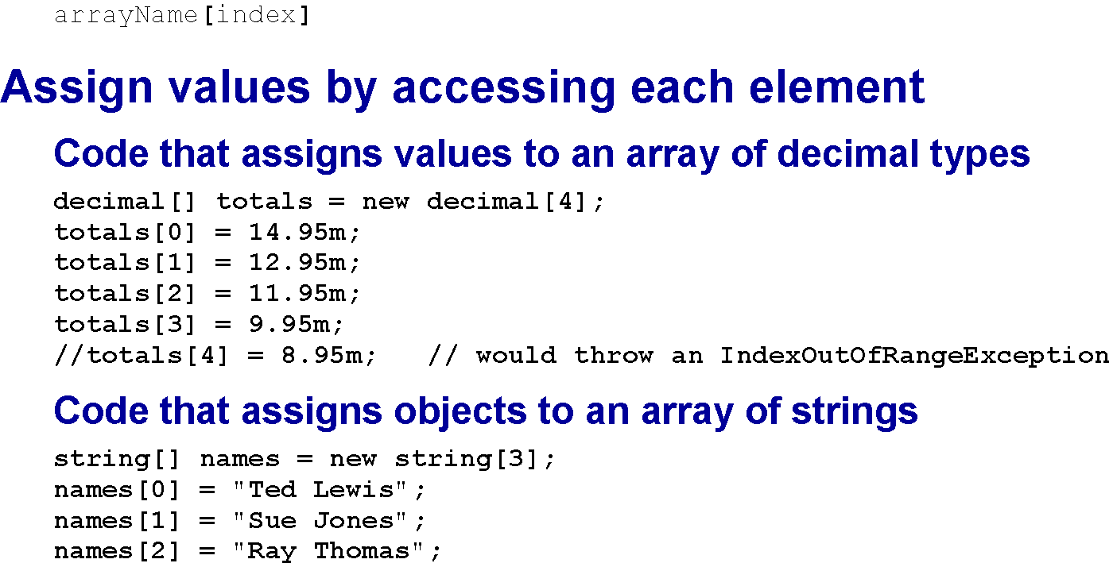
Refer to an element of an array

Slide 8
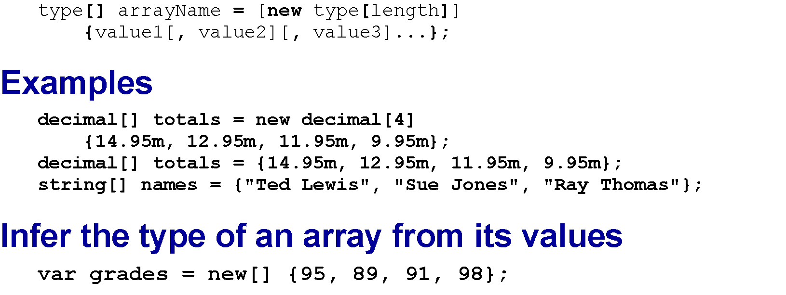
Creating an array and assigning values in one statement

Slide 9
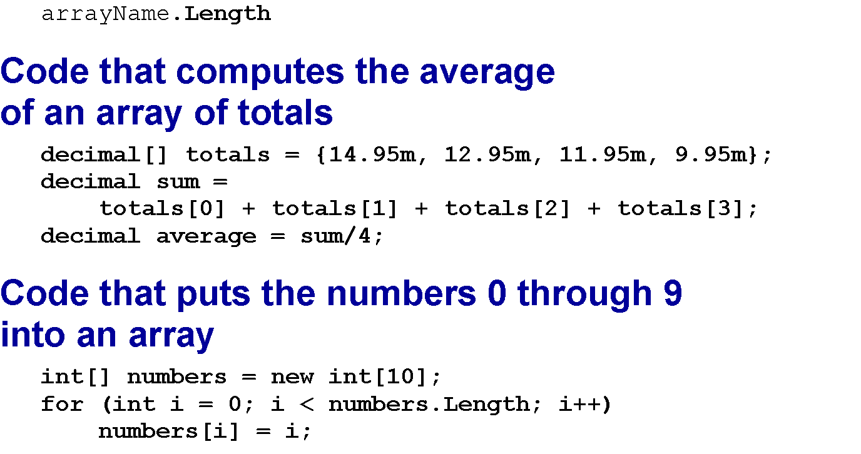
Using the Length property

Slide 10
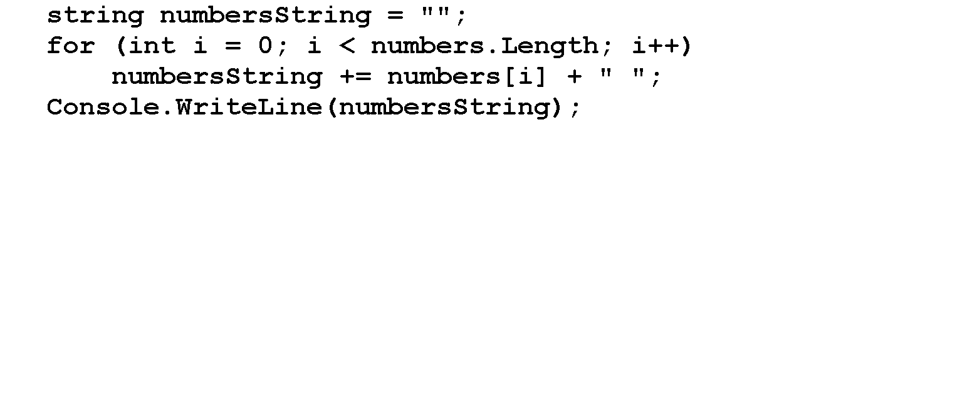
Display the numbers array

Slide 11
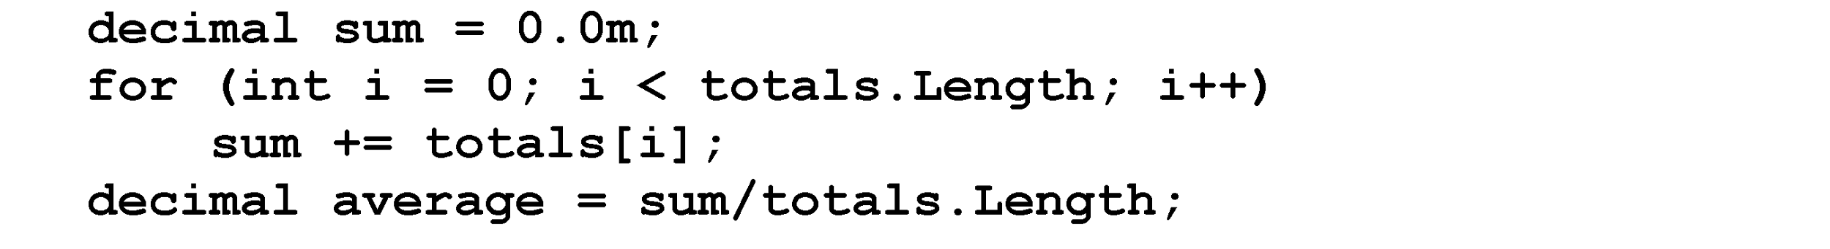
A for loop that computes the average of the totals array

Slide 12
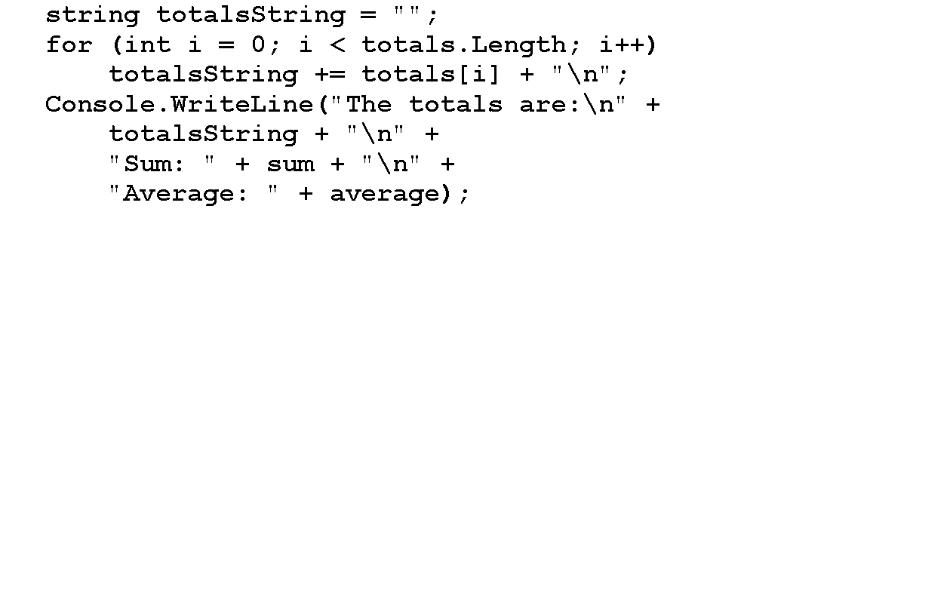
Display the totals array

Slide 13
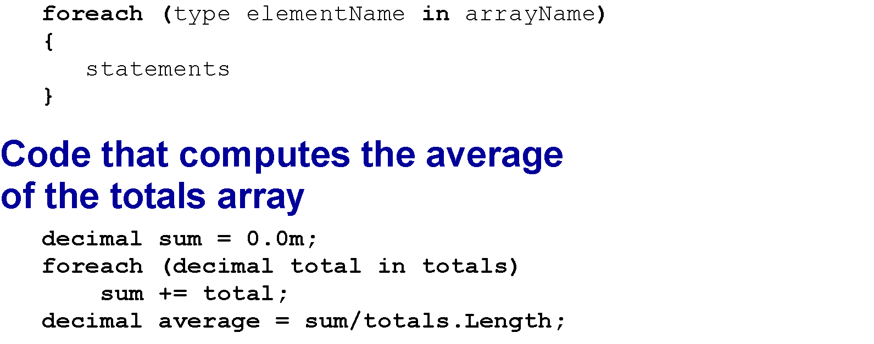
The syntax of a foreach loop

Slide 14
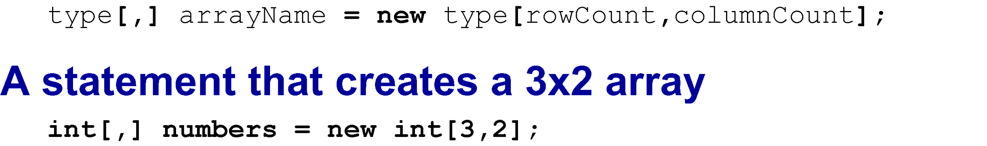
Rectangular array

Slide 15
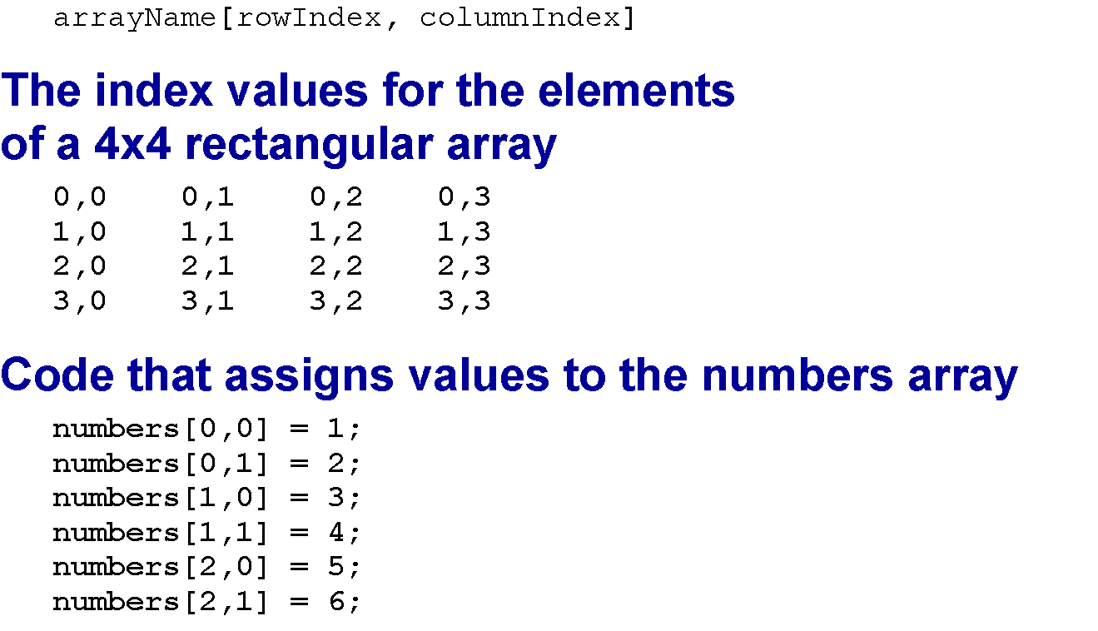
Referring to an element of a rectangular array

Slide 16
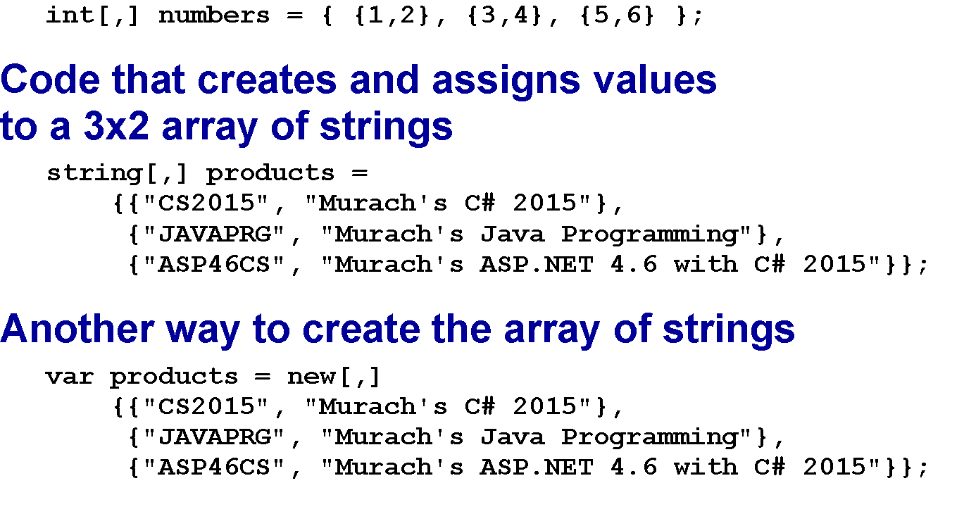
Creates a 3x2 array and assign values with one statement

Slide 17
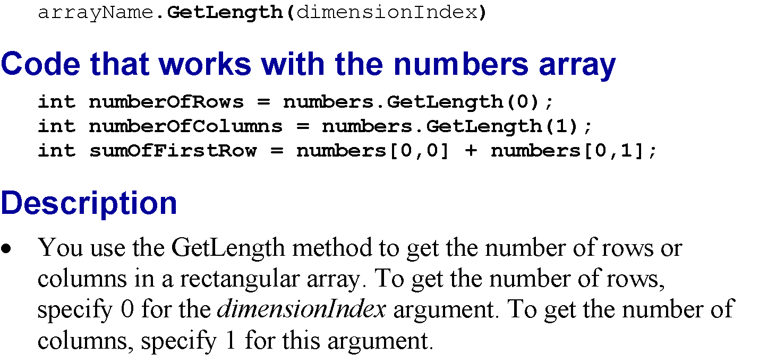
Using the GetLength method

Slide 18
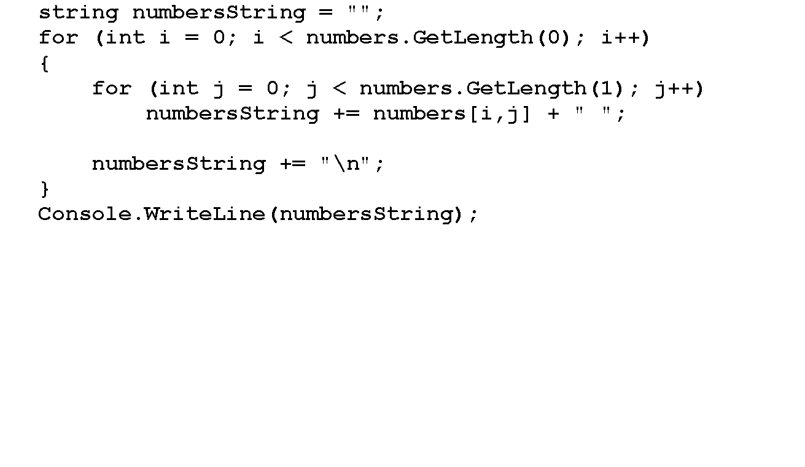
Display the numbers array

Slide 19
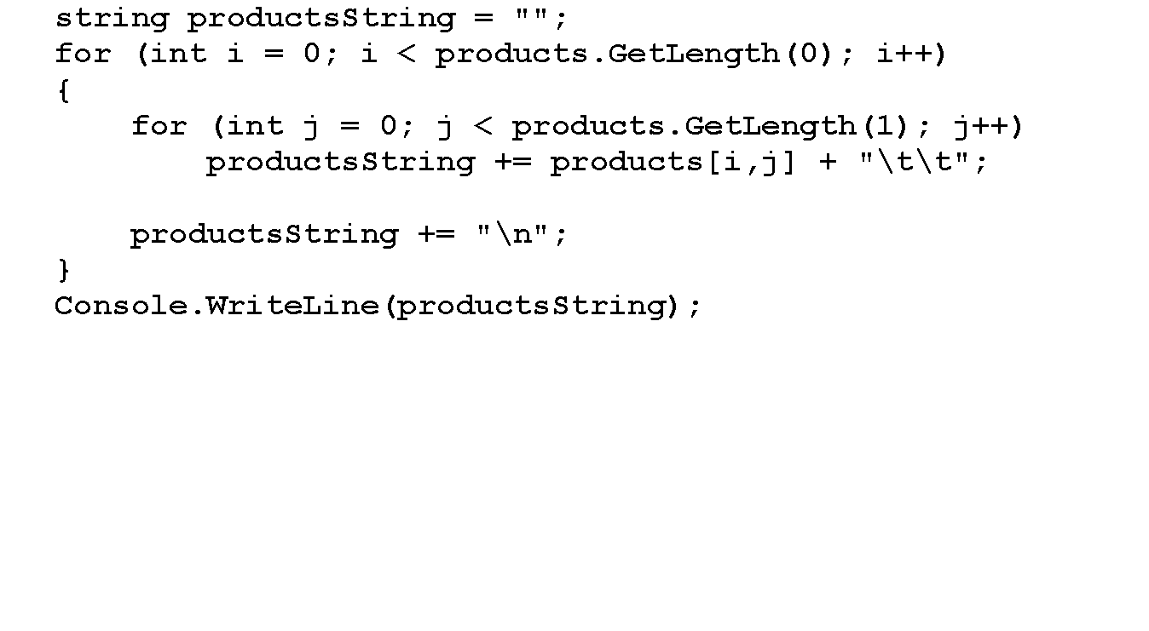
Display the products array

Slide 20
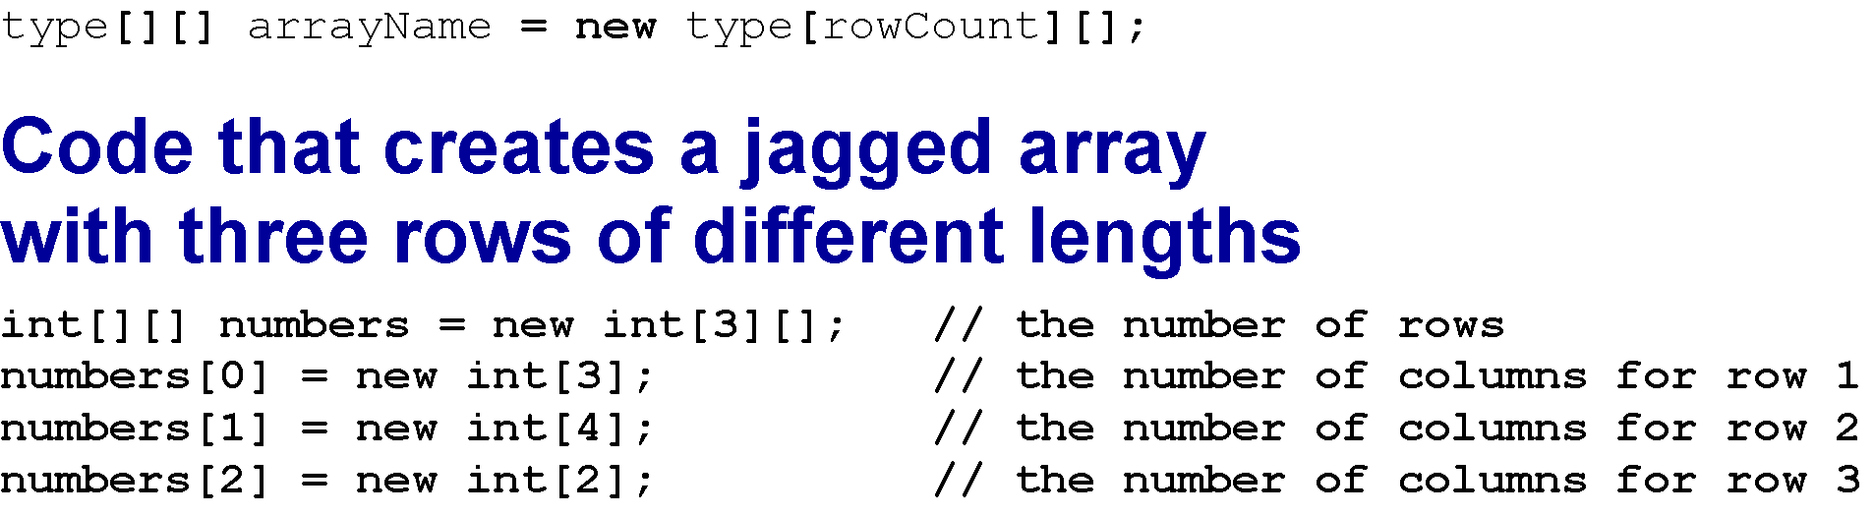
Creating a jagged array

Slide 21
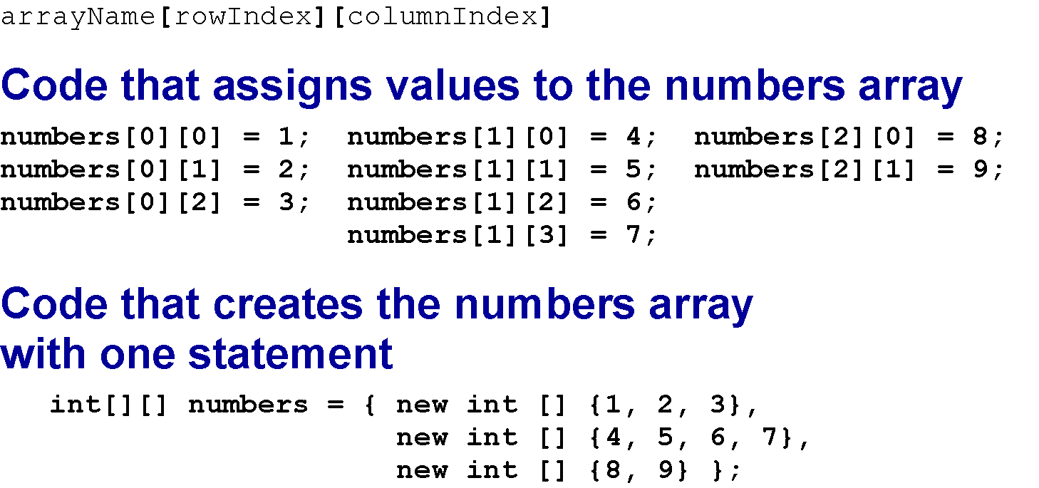
Referring to an element of a jagged array

Slide 22
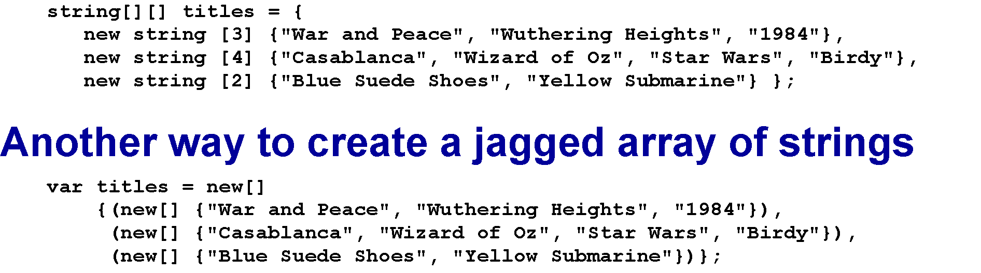
Jagged array of strings

Slide 23
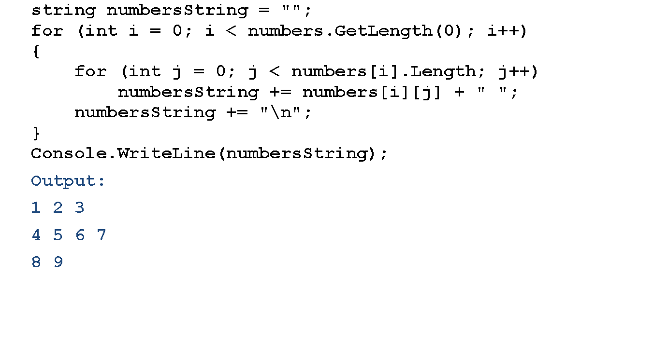
Code that displays the numbers

Slide 24
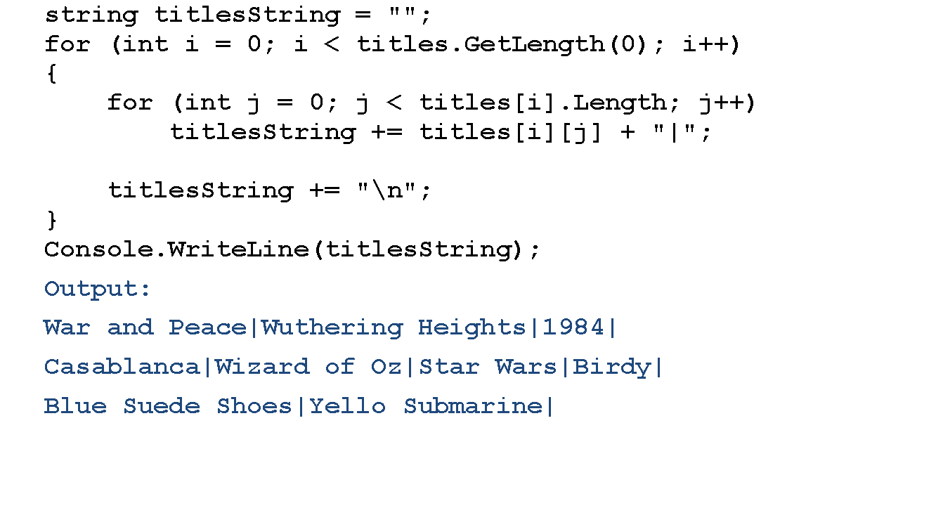
Display the titles array code

Slide 25
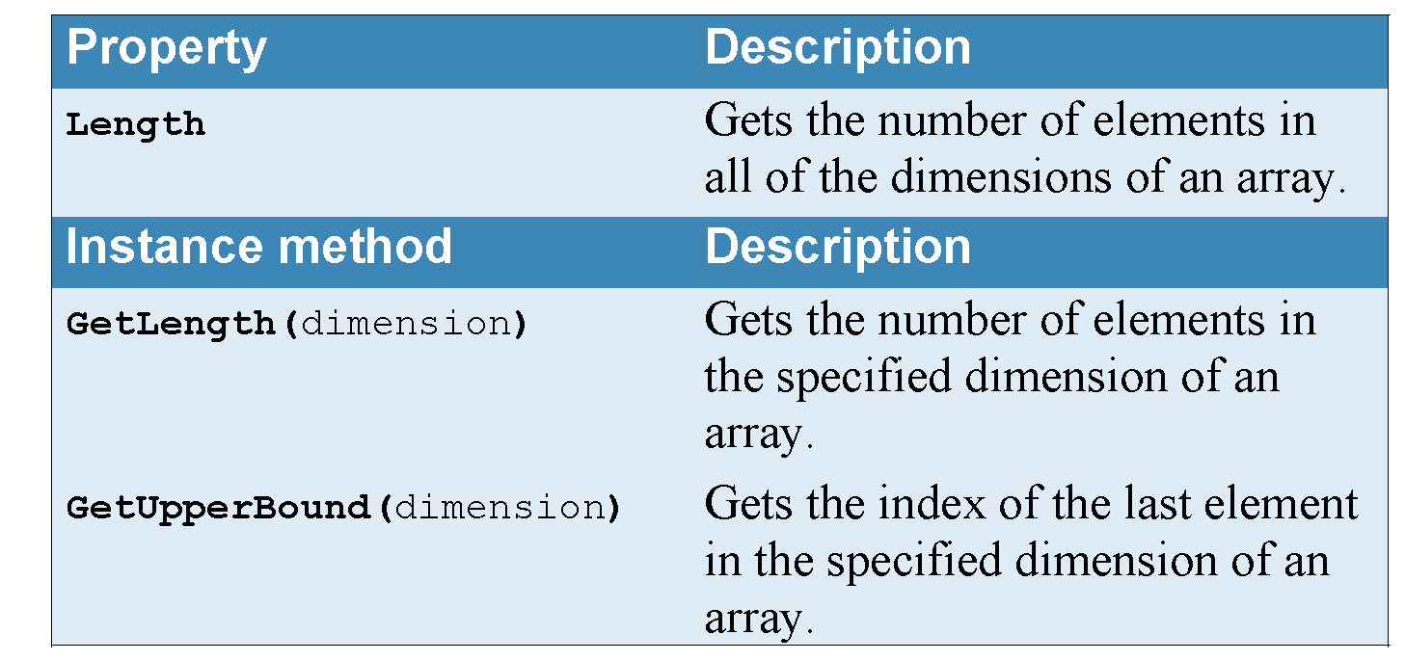
Common properties and methods of the Array class

Slide 26
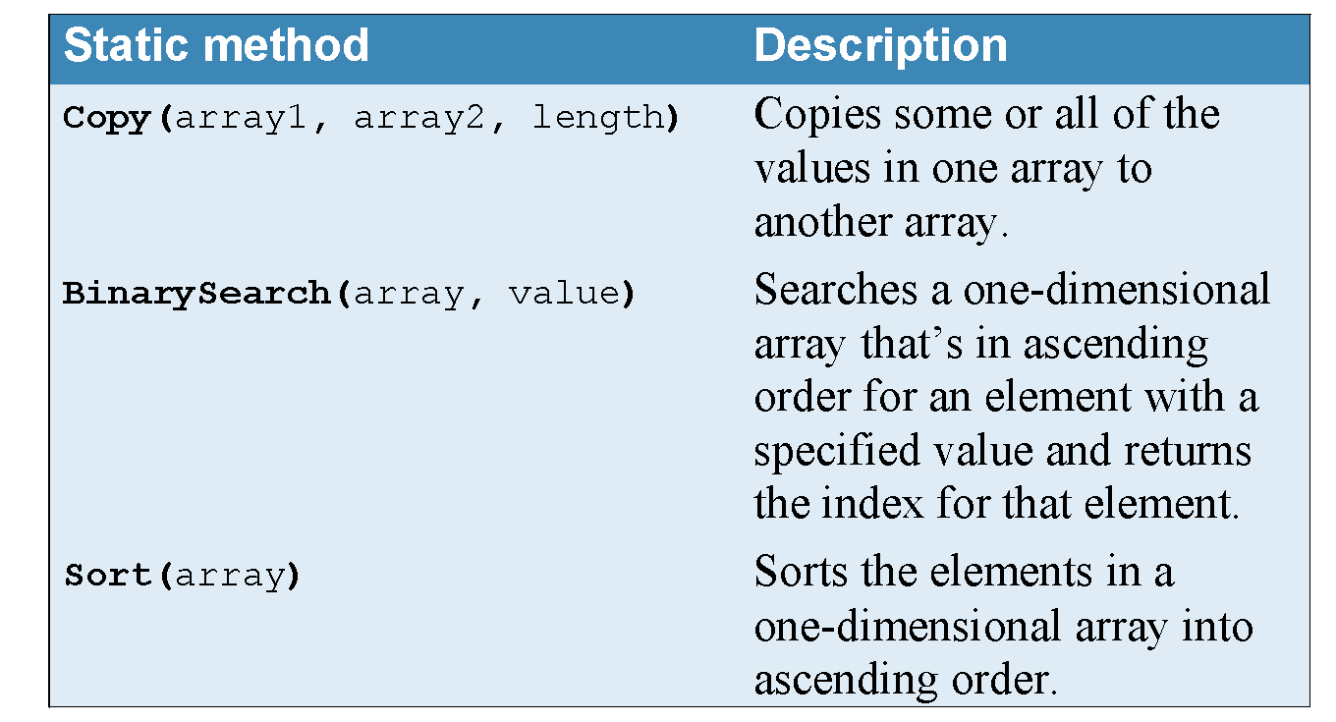
Common properties and methods of the Array class

Slide 27
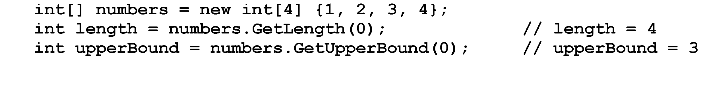
Code that uses the GetLength and GetUpperBound methods

Slide 28
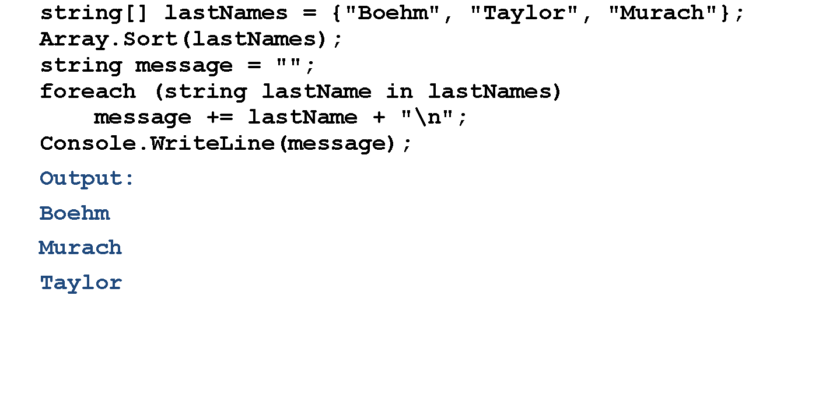
Using the Sort method

Slide 29
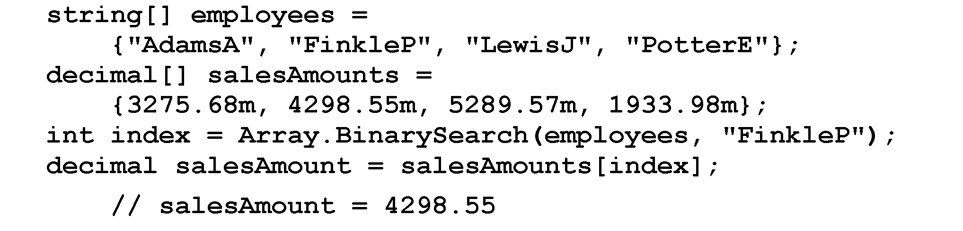
The BinarySearch method

Slide 30
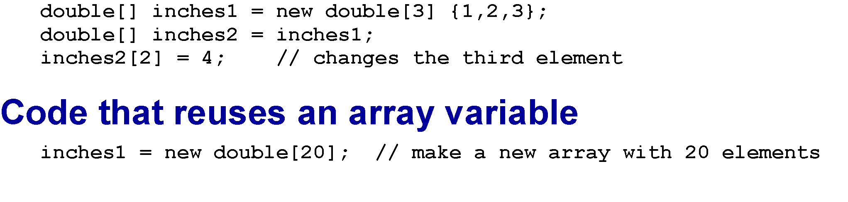
Referencing to another array

Slide 31
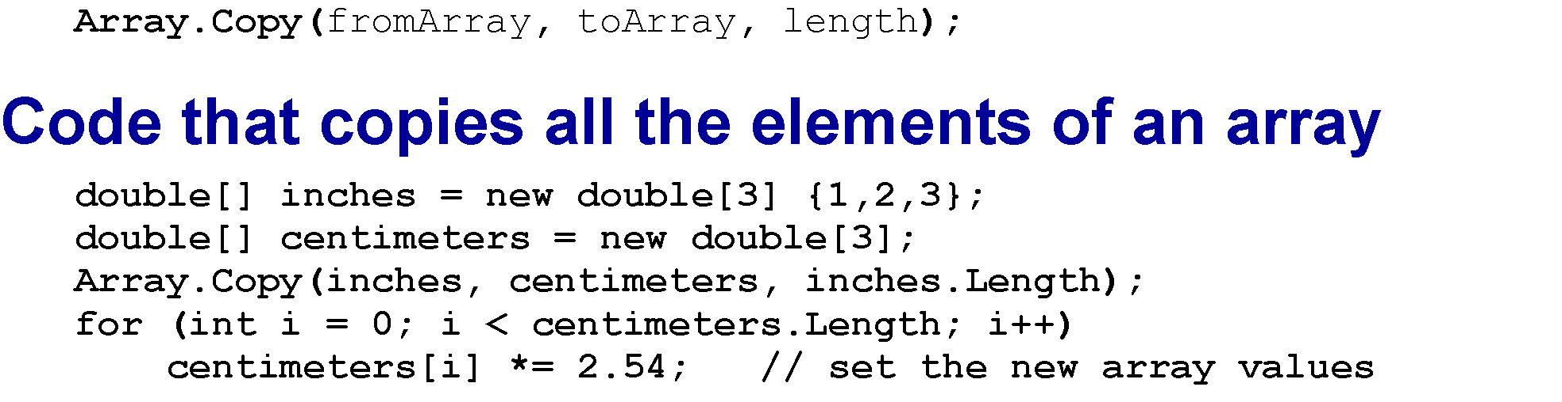
Copying elements of an array

Slide 32
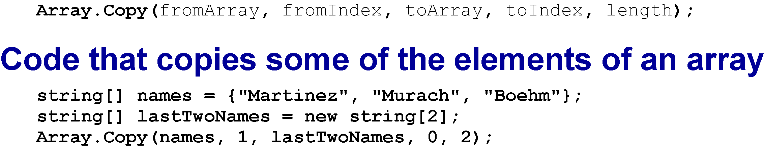
Copying selected elements from one array to another

Slide 33
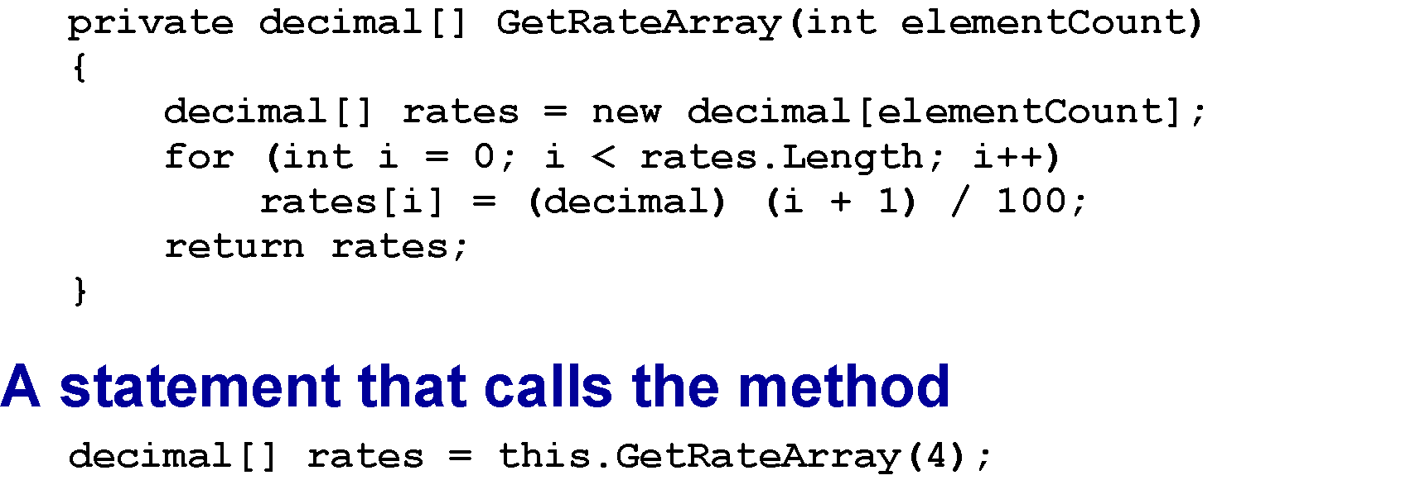
Returning an array

Slide 34
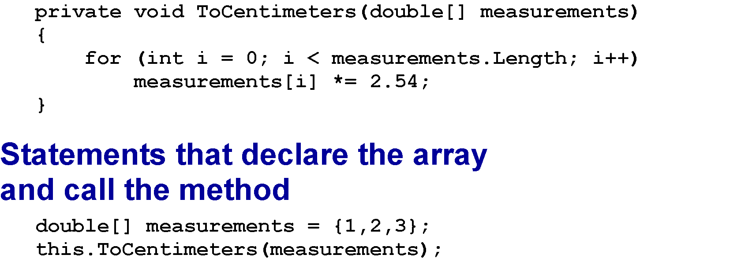
A method that accepts an array argument

Slide 35
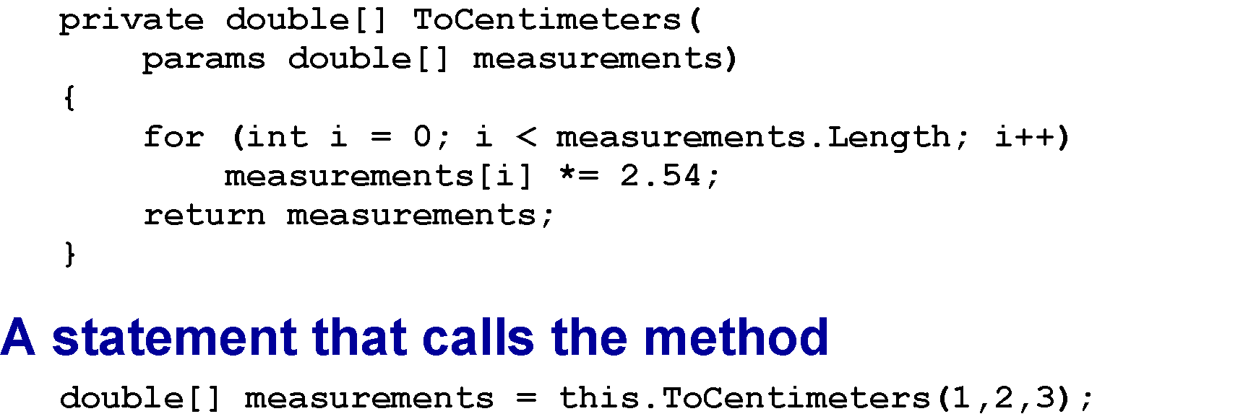
A method that uses the params keyword

Slide 36
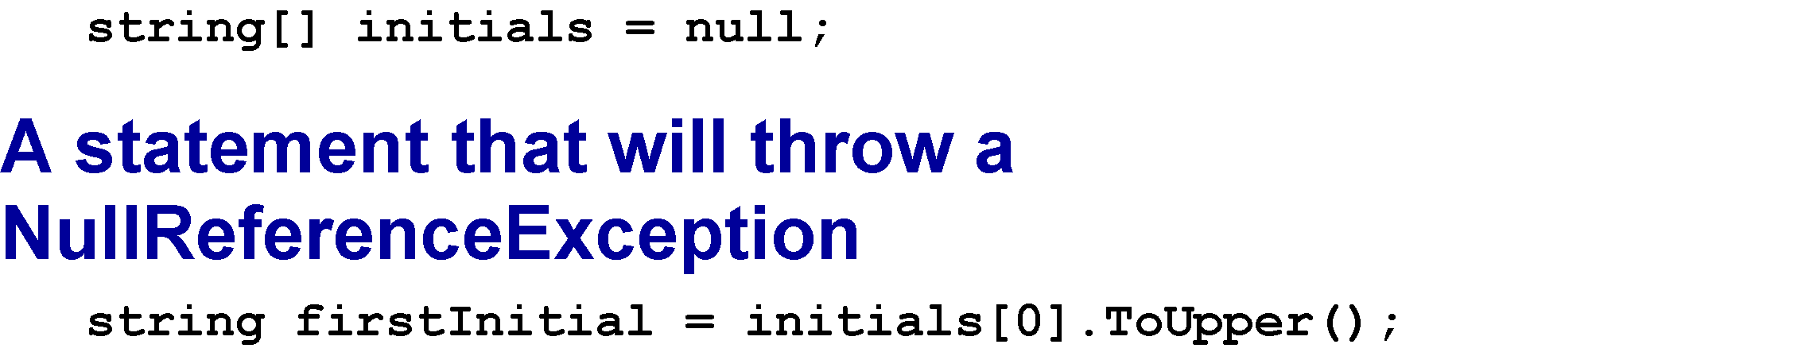
A statement that creates a null array

Slide 37
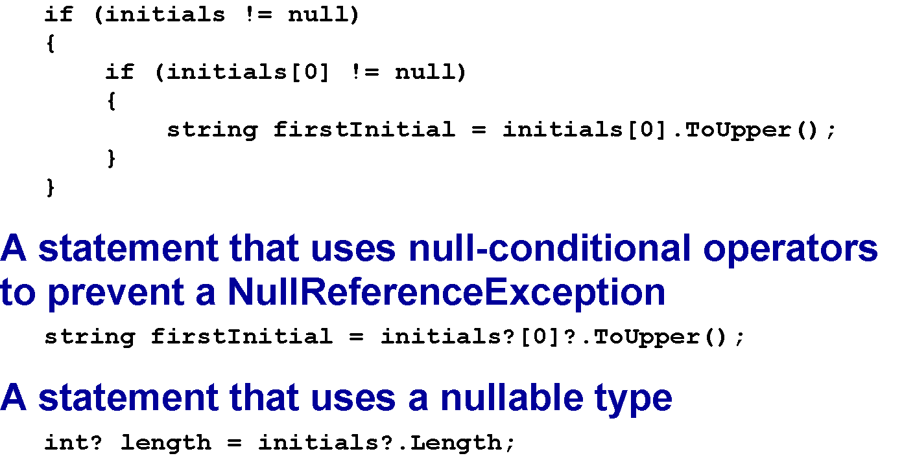
Code that uses if statements to prevent a NullReferenceException

Slide 38
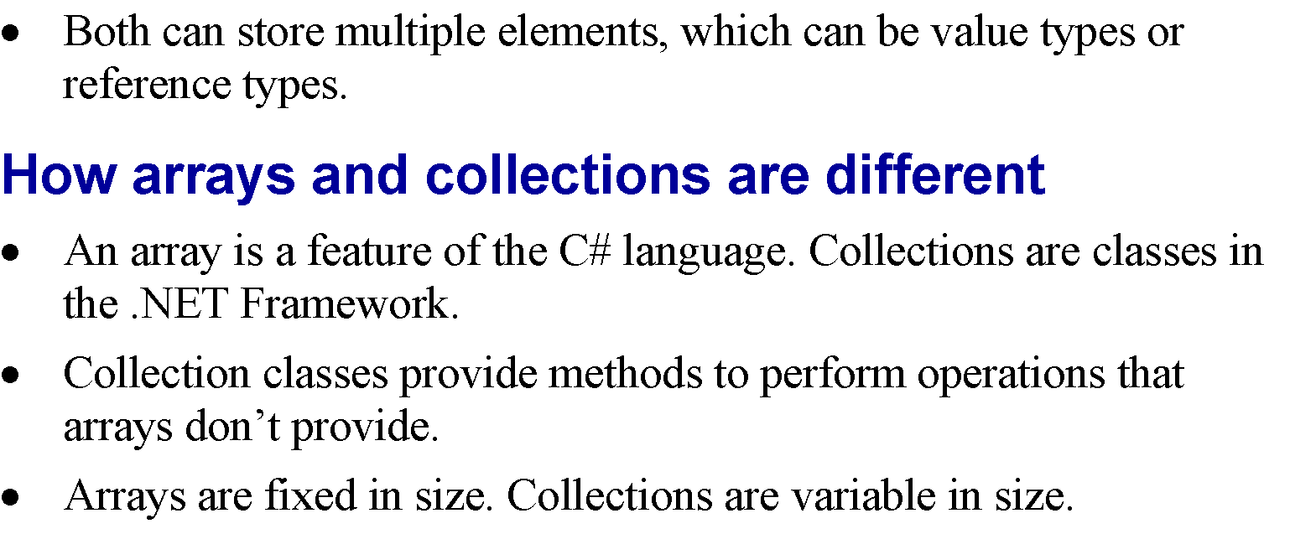
Comparing arrays and collections

Slide 39
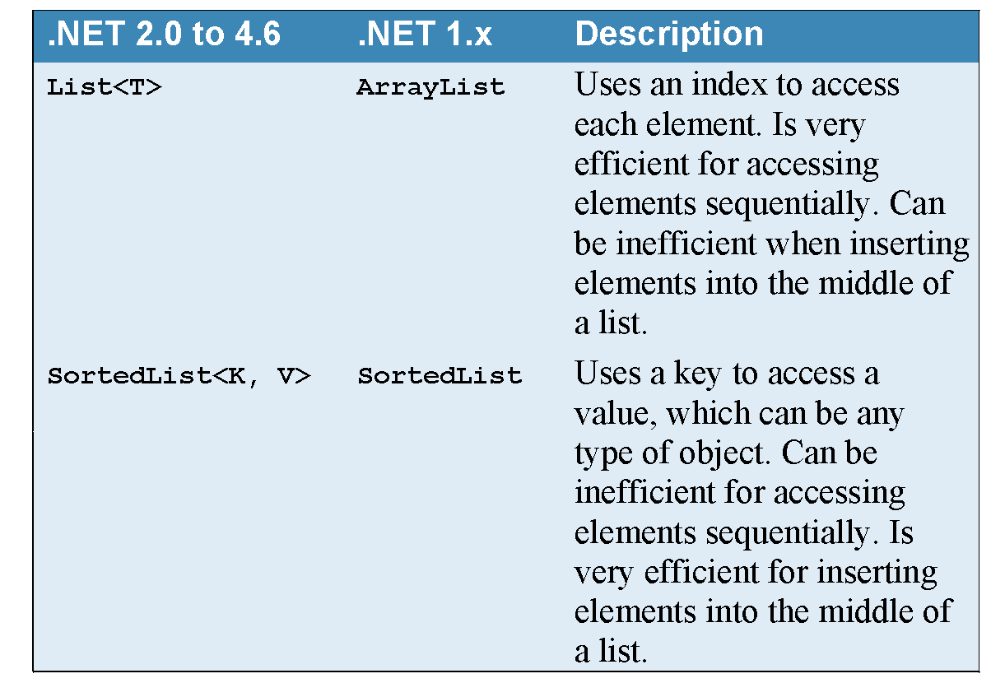
Commonly used collection classes

Slide 40
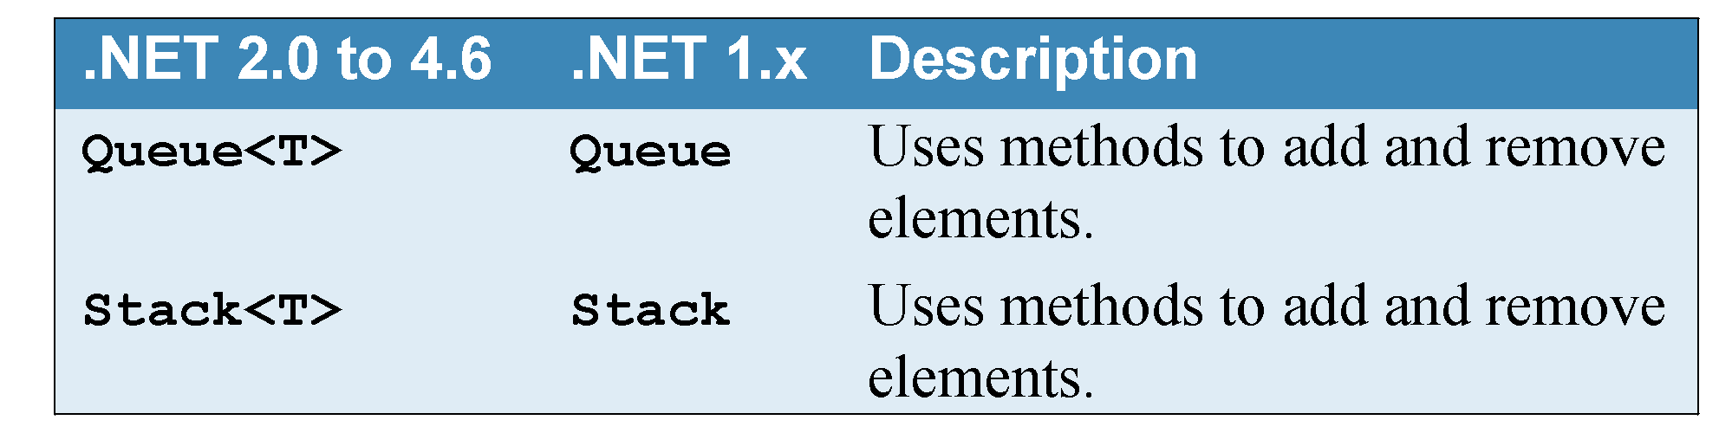
Commonly used collection classes

Slide 41
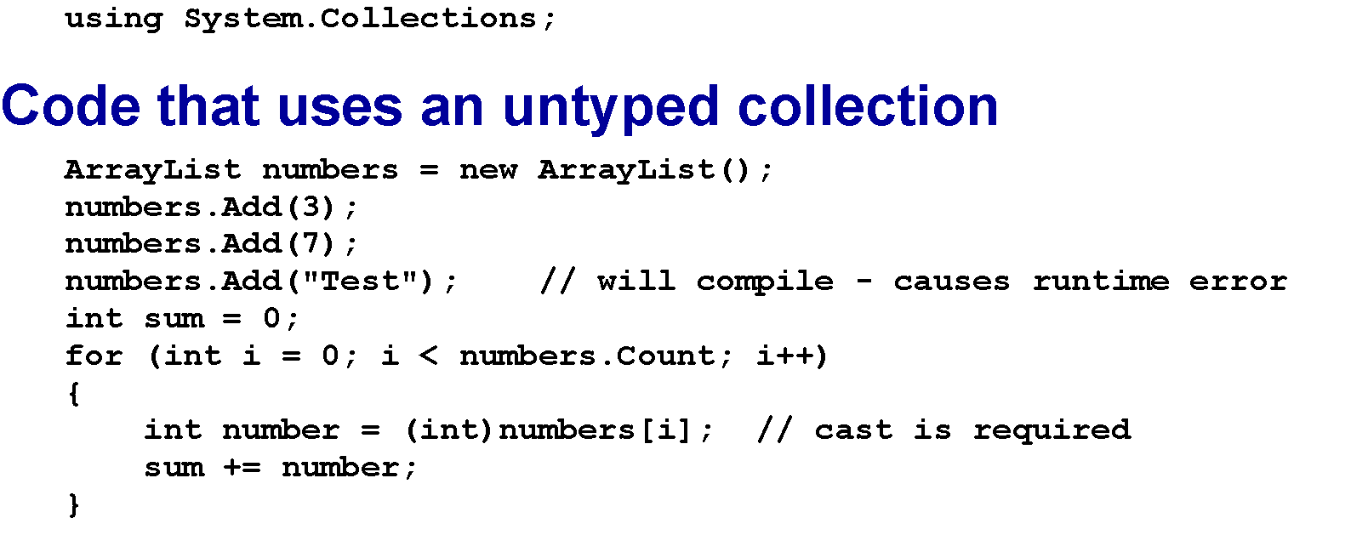
The using directive for untyped collections

Slide 42
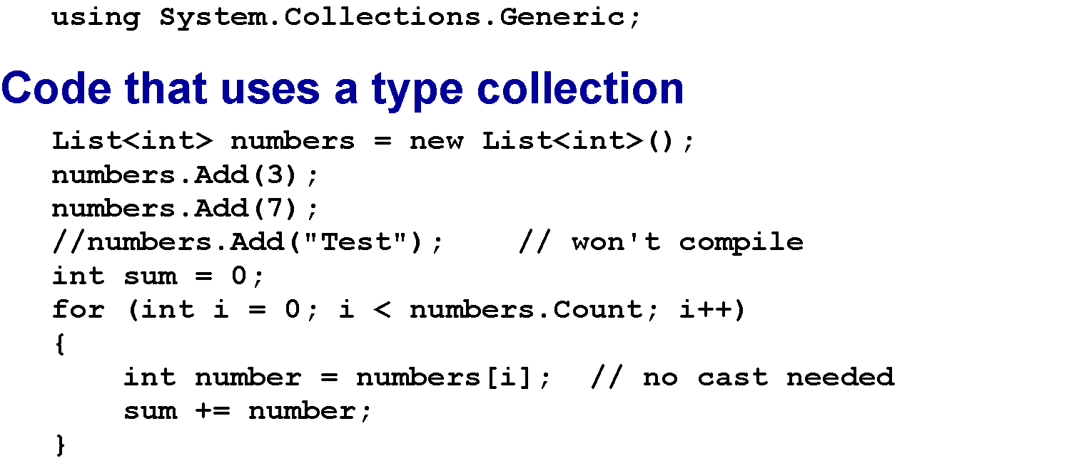
The using directive for typed collections

Slide 43
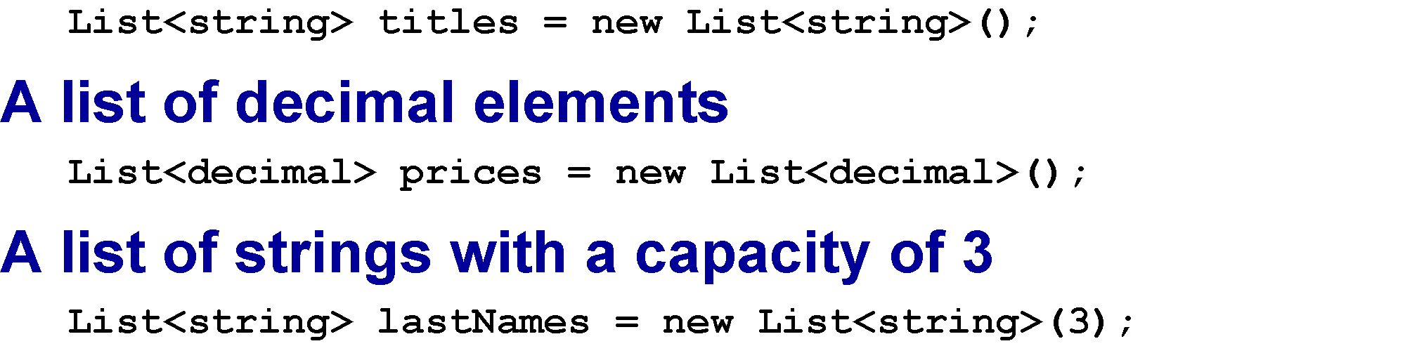
A list of string elements

Slide 44
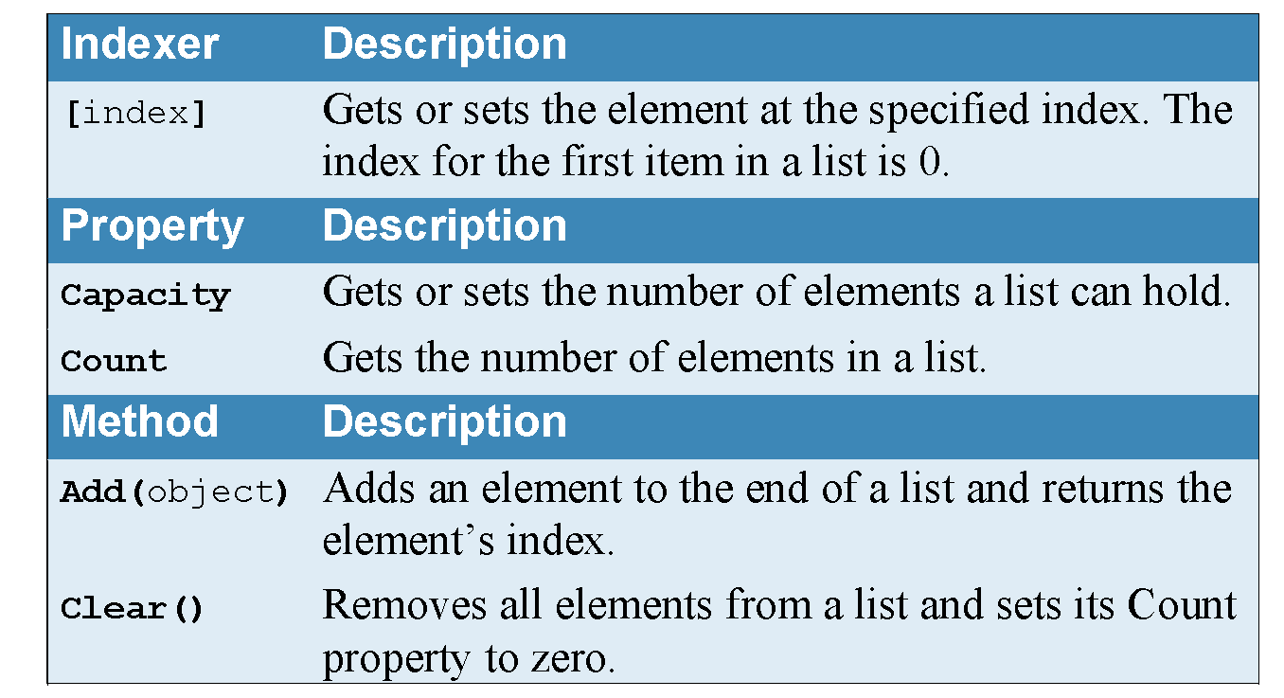
Common properties and methods of the List<> class

Slide 45
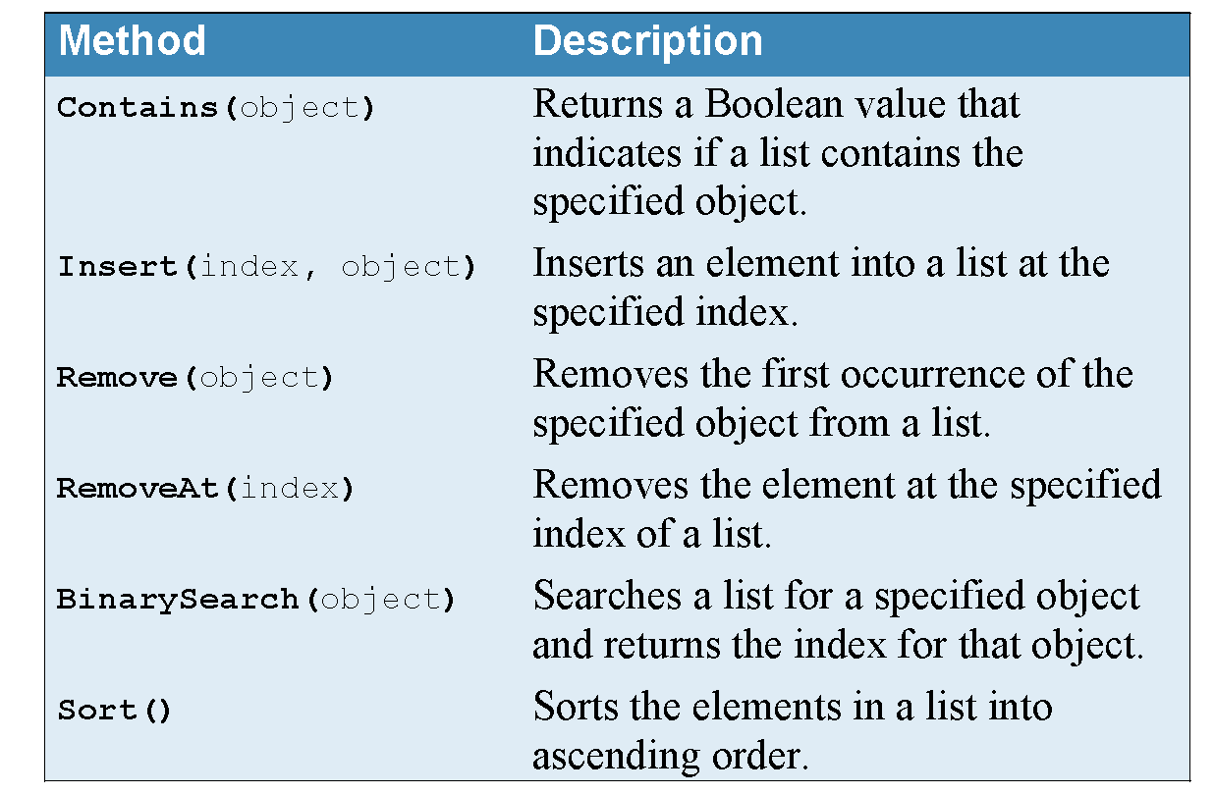
Common properties and methods of the List<> class (cont.)

Slide 46
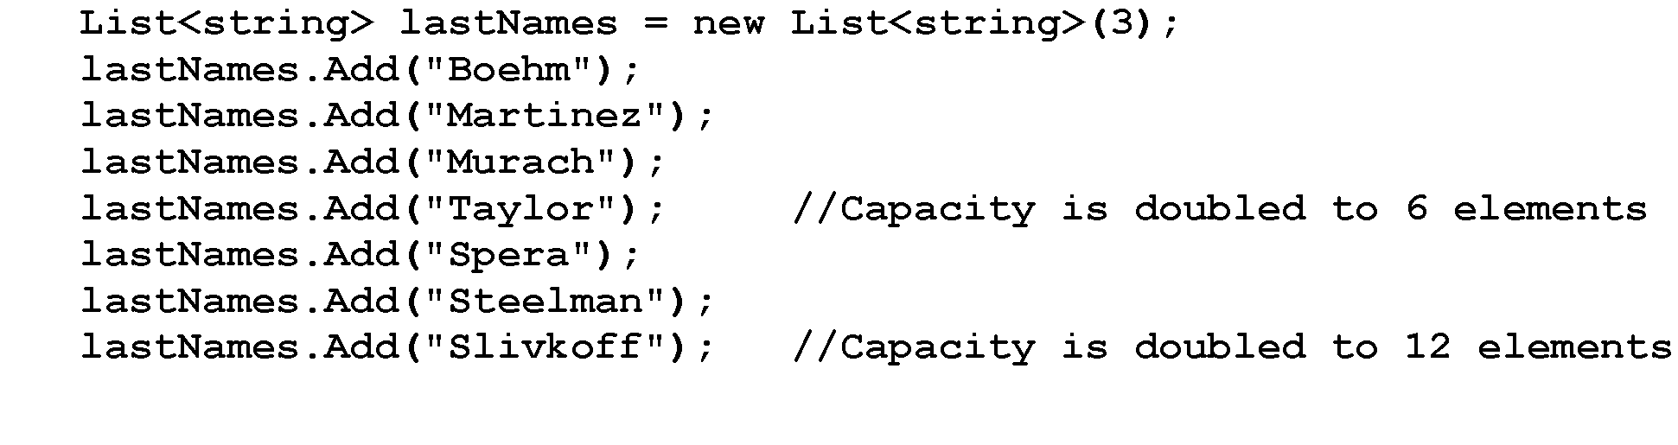
Code that causes the size of a list of names to be increased

Slide 47
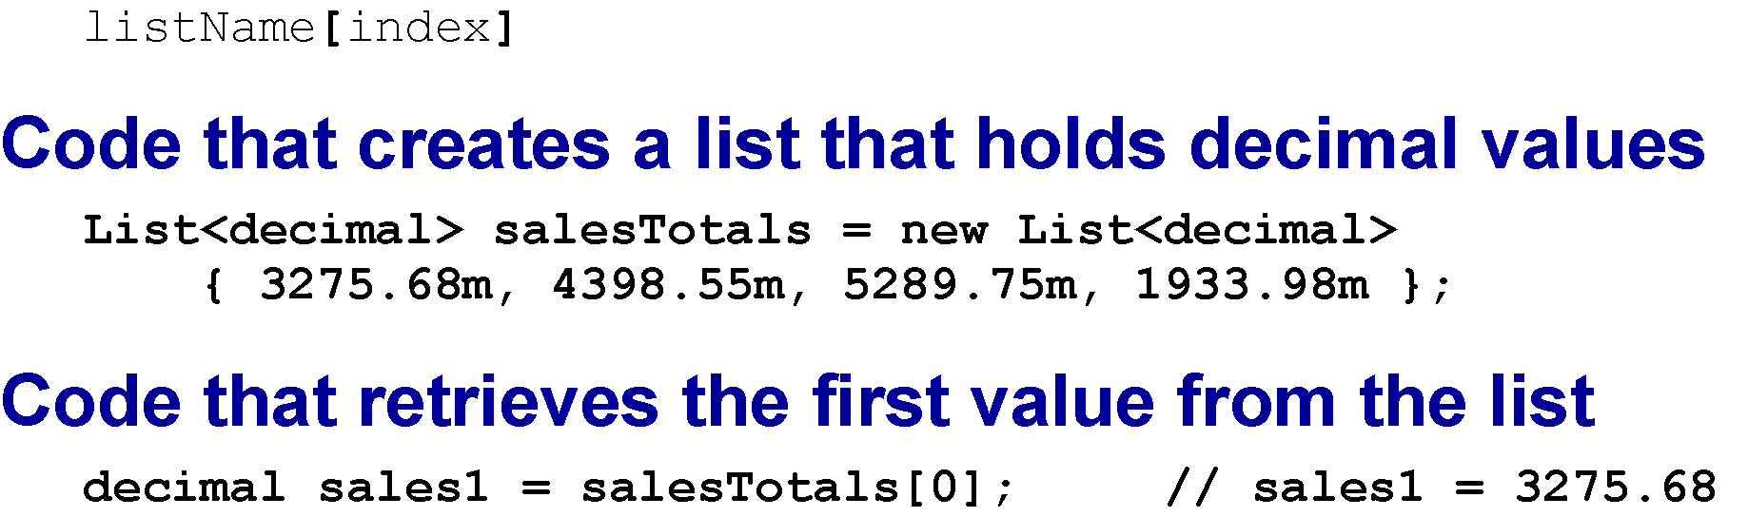
Retrieving a value from a list

Slide 48
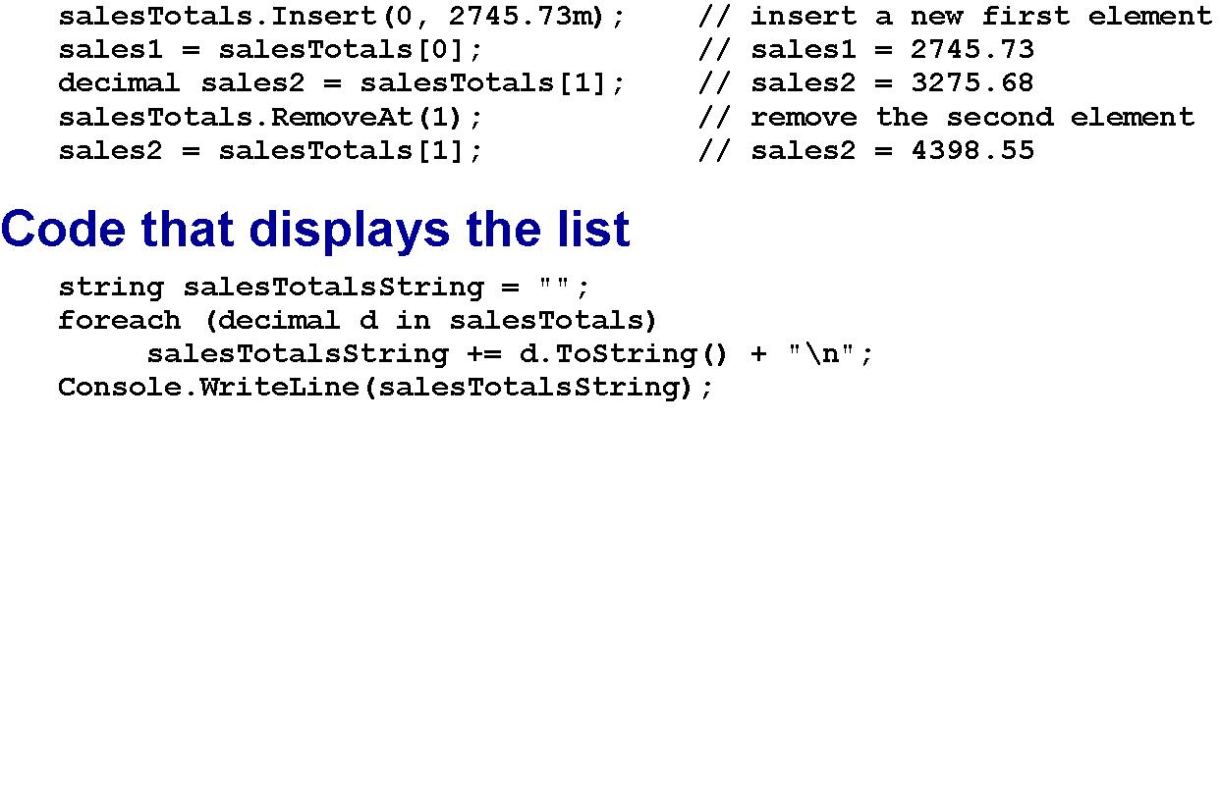
Code that inserts and removes an element from the list

Slide 49
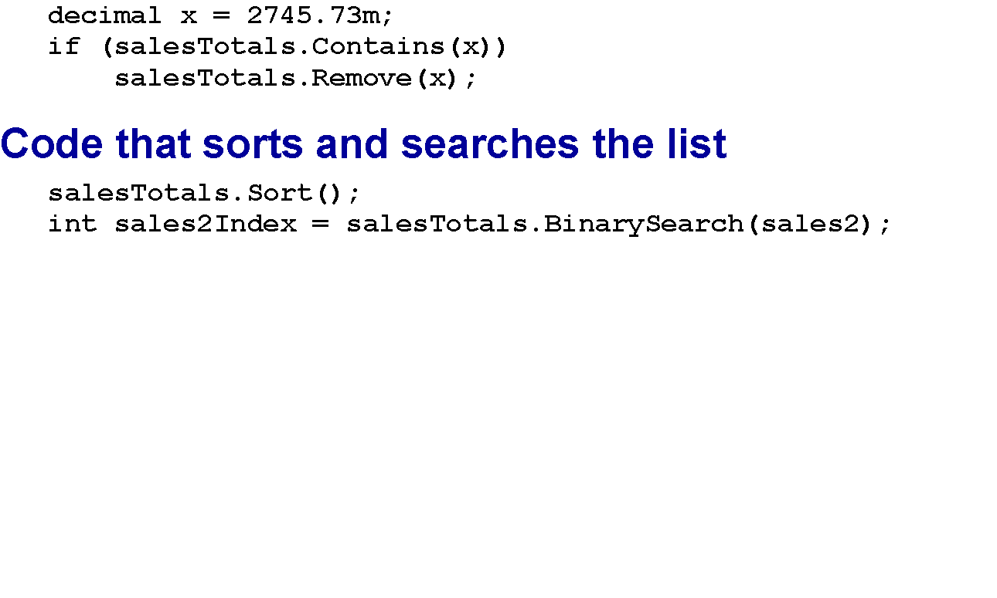
Code that checks for an element in the list and removes it if it exists

Slide 50
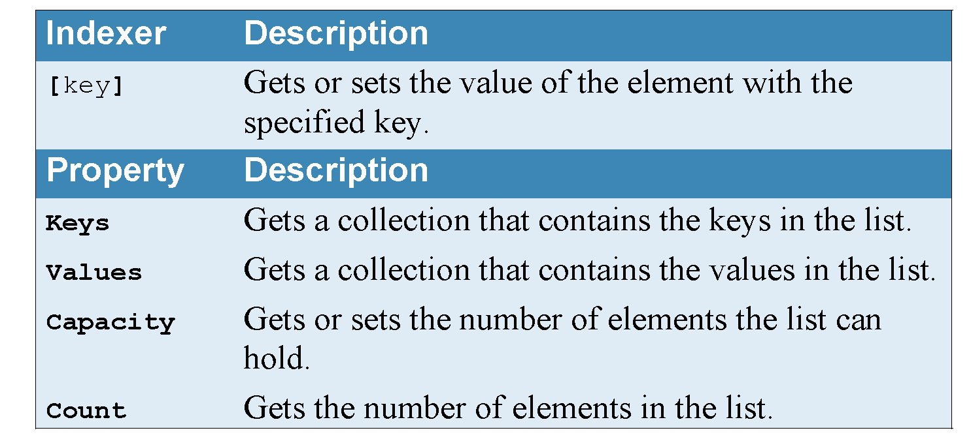
Common properties of the SortedList<> class

Slide 51
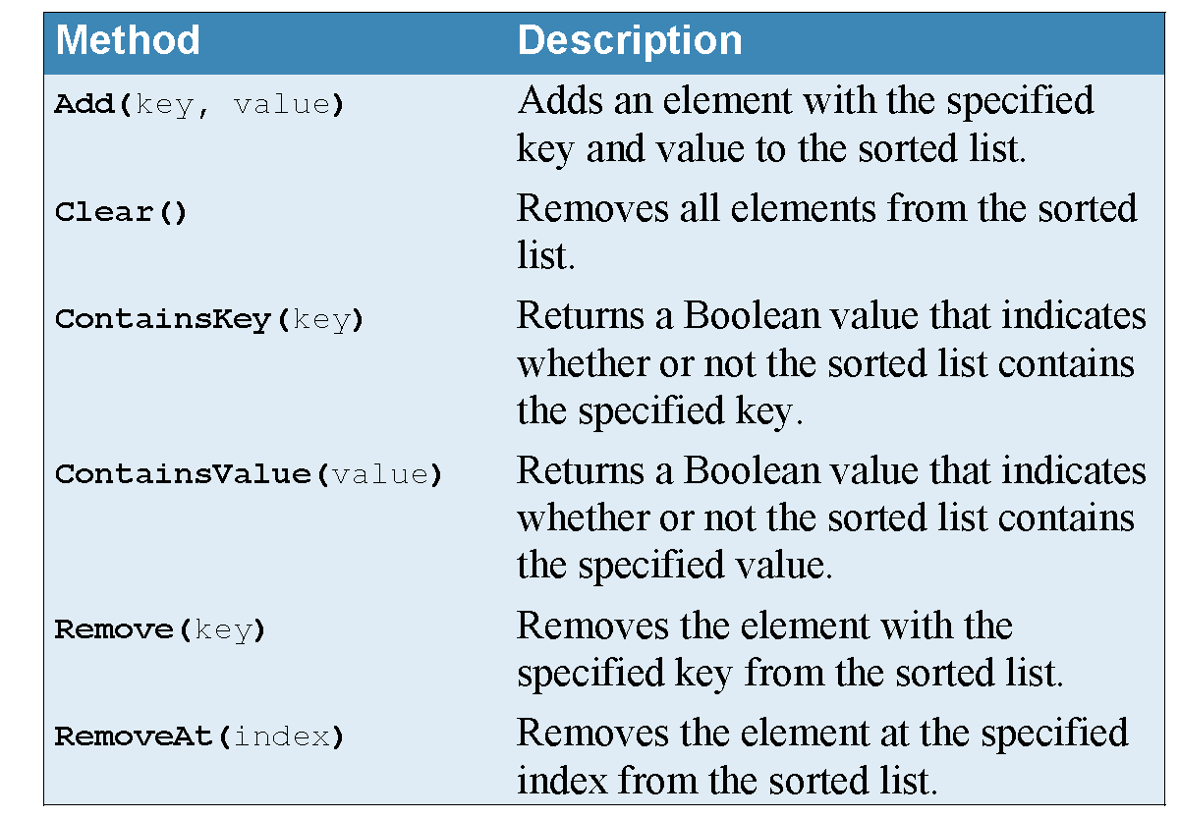
Common methods of the SortedList<> class

Slide 52

Properties of the KeyValuePair<K, V> structure

Slide 53

How to create and load a sorted list

Slide 54

Code that looks up a value in the sorted list based on a key

Slide 55

Properties and methods of the Queue<> class

Slide 56

Code that uses a queue

Slide 57

Properties and methods of the Stack<> class

Slide 58

Code that uses a stack

Slide 59

The syntax for retrieving a value from an array list

Slide 60

Code that inserts and removes an element from the array list

Slide 61

Checking for an element in the array list and removes it if it exists

